Slide 1
NoMorePrivacy:
Daily Activity Recognition using Armband
Tao Feng
Zhiyuan Zheng
Lei Liu
Yuan Xia
May 13, 2015
ECE 498
Final Project

Slide 2
Introduction & Motivation
Our Goal
  Detect user's daily activities
    User can know what she/he did on minutes resolution
Motivation
  Good for Personal Time Management
  Health Care for Doctor and Patient
    Score your health condition based on your living pattern
  Find people with the similar living pattern, hobbies etc..
  Good for advertisement

Slide 3
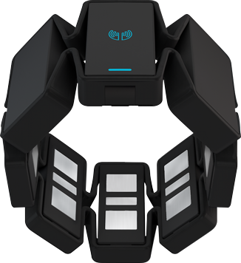
Devices
MYO Armband
Sensors
  Medical graded EMG sensors (8)
  3-axis gyroscope
  3-axis accelerometer
  3-axis
    Roll
    Pitch
    Yaw
  *Frequency: 20 samples/second
  can be changed
Image source https://d1yjwyup50ou7g.cloudfront.net/static/c3b4317/img/techspecs/myo_image_black.png

Slide 4
System Design Overview: NMP
Real time Signal Streams
  ⬇
Sliding Window(s)
  ⬇ Feature extraction(stat)
  e.g.: mean, median, var, num_mean_crossing
  ⬇Recognition
Unit_patterns (sequence)
    e.g: running, dribbling, shooting_a_ball, writing
  ⬇ Feature extraction (BoW)
Unit_pattern count
  ⬇ Recognition
Activity
  e.g: playing basketball, driving, eating,
  Programming, taking class
  Natural Language Processing :
Text (word sequence)
  ⬇ Feature extraction (BoW)
Word count
    ⬇  Recognition
  Topic

Slide 5
Technical Challenge
Recognize a new unit pattern or an activity which has been not been detected.
Detect unit patterns from signals
Detect activities from sequence of unit patterns

Slide 6
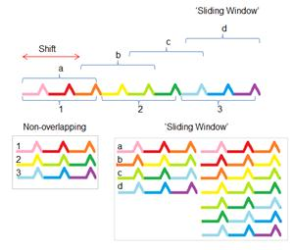
Real time unit pattern recognizing/matching
Mean, Median, Variance, Mean_Crossing_Count
etc..
Generates 36 feature dimensions for every sliding window
1. Recognize unit patterns:
Walking, running, idle, driving, dribbling, waving, flipbook, typing
New unit pattern(s) detected by GMM or K-means
  When maximum probability (GMM) or distance (K-means) below certain thresh hold, we claim new patterns discovered and re-train the clustering model

Slide 7
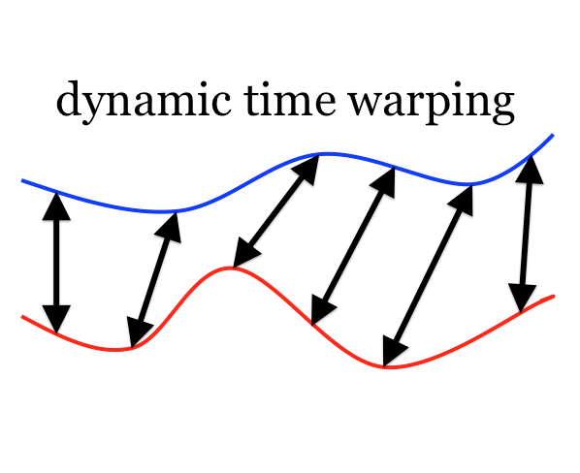
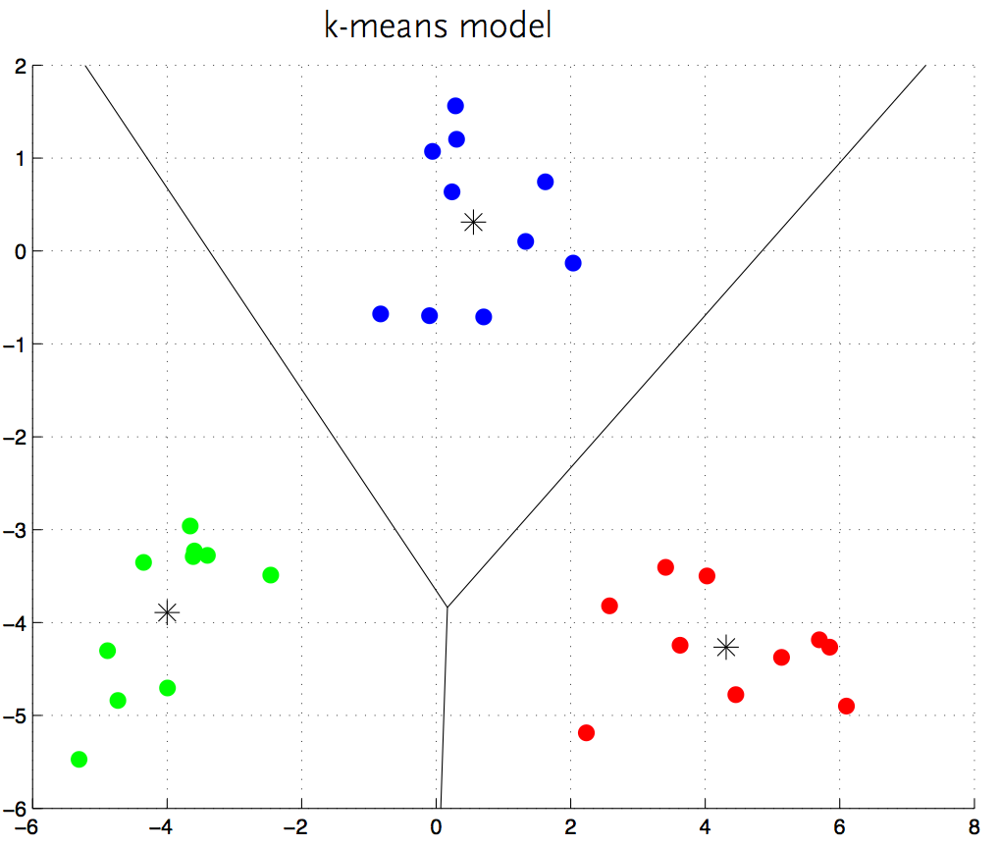
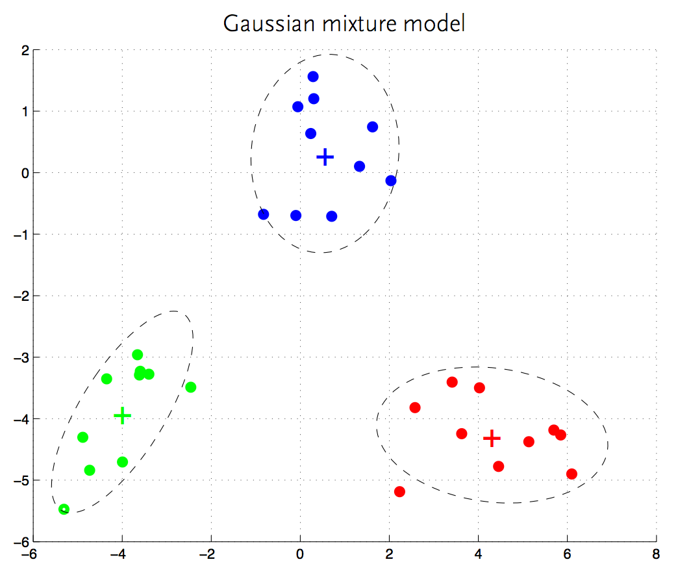
New Pattern Discovery
Goal: Discover a new unit pattern when it has been repeatedly detected
Method Used
Dynamic Time Warping
K-means Clustering
Gaussian Mixure Model(GMM)

Slide 8
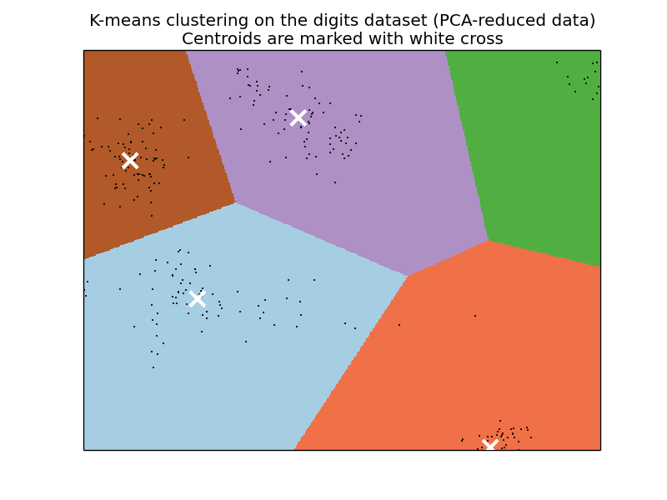
New Pattern Discovery(K-means Clustering)

Slide 9
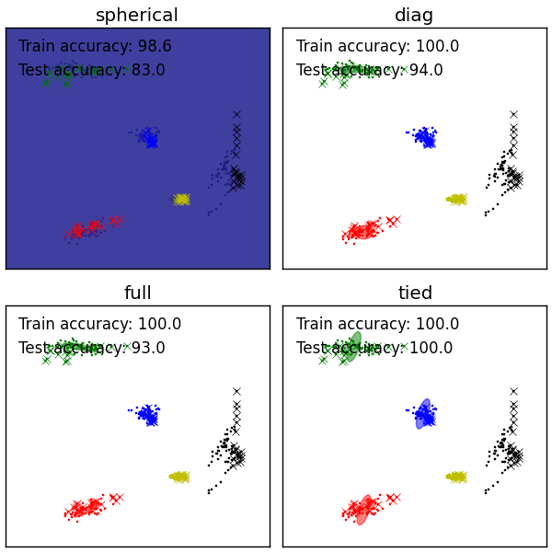
New Pattern Discovery(GMM)

Slide 10
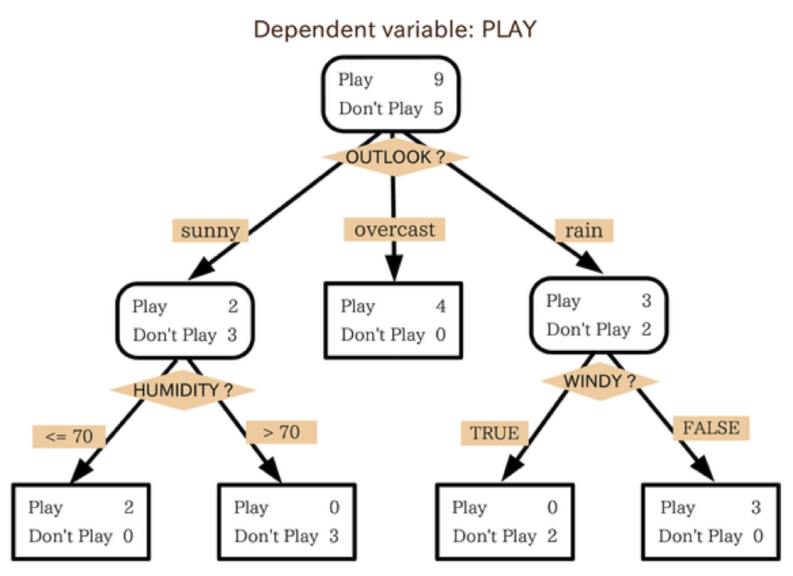
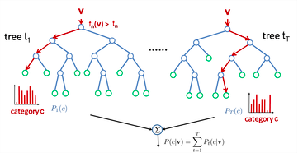
Pattern Detection:
Decision Tree and Random Forest

Slide 11
Random Forest VS. Support Vector Machine
Issue of data normalization for sliding window
  1. Features (stats) might have large variation as time shift
  2. Hard to choose generic scaling parameters (mean, var) across time
  3. SVM doesn’t work well
Random Forest doesn’t require data scaling
  Very suitable for real time signal-generated features

Slide 12
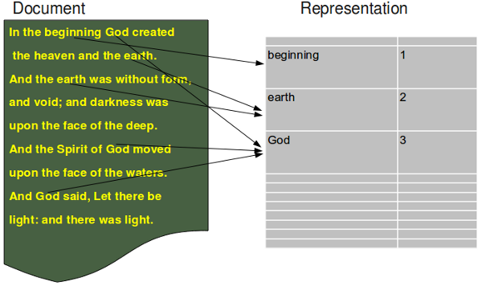
Bag of Words: text word count → Topic
Topic tag: BIBLE

Slide 13
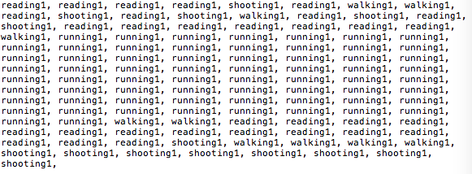
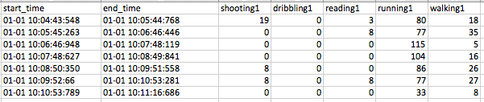
Bag of Words: unit pattern count → Activity
Label tag: Playing basketball

Slide 14
Evalution(New Pattern Discovery)
 | reading | walking | shooting | dribbling | running | boxing | cutting | toothing | Typing
reading | 0.3 | 0 | 0 | 0 | 0 | 0 | 0 | 0 | 0
walking | 0 | 0.2 | 0 | 0 | 0 | 0 | 0 | 0 | 0
shooting | 0 | 0 | 0.6 | 0 | 0 | 0 | 0 | 0 | 0
dribbling | 0 | 0 | 0 | 0.4 | 0 | 0 | 0 | 0 | 0
running | 0 | 0 | 0 | 0 | 0.5 | 0 | 0 | 0 | 0

Slide 15
Evalution(Unit Pattern and Activity)
 | Offline Evaluation Accuracy | Online Evaluation Accuracy
Unit Pattern | 98+% | 80%
Daily Activity | 87% | Quite accurate, Not measured yet See DEMO
Test on 3 activities based on 9 unit pattern

Slide 16
Conclusion
Accomplishment
  Accurately distinguish different unit pattern
  Complete and generic framework that convert signals to activities, scalable to more heterogeneous feature
  Apply NLP techniques to mobile signal processing
Limitation
  Not accurately distinguish new pattern and existing pattern
  Calibration: error rate increases if person_2 test on person_1’s trained model
Future Work
  Improve the accuracy of new patterns discovery
  Incorporate EMG signal data
  Integrate the back-end with mobile front-end
  Incorporate the duration of an activity (logging everything, NMP)
  Combine our system with Indoor Localization
    Multimodal improves the inference accuracy

Slide 17
DEMO
Unit patterns:
guitar_foot_on_chair, guitar_standing, guitar_sitting
idle_sitting, idle_standing, running, walking
dribbling, shooting
Activities:
live_concert : (guitar_foot_on_chair, guitar_standing, idle_standing, walking)
play_basketball (running, shooting, dribbling)
guita_practicing (guitar_sitting, idle_sitting)

Slide 18
Work Distribution
Tao Feng taofeng1
Design the general system architecture of LayeredSense
Implement the signal data streams from Myo armband API.
Implement the machine learning algorithms for unit pattern recognition and activity recognition
Design the accuracy measurement.
Zhiyuan Zheng zheng55
Test explore and implement new unit pattern recognitions over:
Dynamic time warping, Kmeans and GMM
Lei Liu liulei5
Design and implement the user interface part
Yuan Xia yuanxia3
Implement the experiment of the activity recognition and report the accuracy

Slide 19
Thank you!

